Slide 1


Components of a Robot
Veritas University, Abuja, Nigeria
(The Catholic University of Nigeria)
Department of Computer and Information Technology
Course: Introduction to Robotics (CSC439)
Lecturer: Engr. Calistus C. Chimezie

Slide 2
Some Basic components of a Robot
The study of robotics focuses on the synthesis of some aspects of human function through the use of components that include the under listed;
Computerized Controllers
Sensors
Actuators
End-Effectors
Joints and links
Note: Though this is considered basic, there are also other components that can be incorporated in the design of a robot.

Slide 3
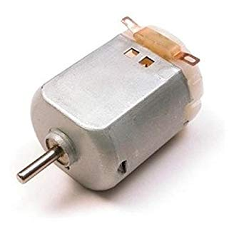
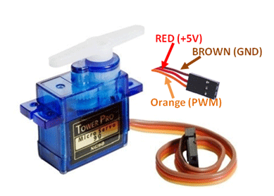
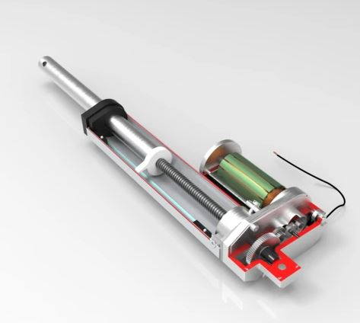
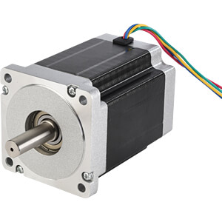
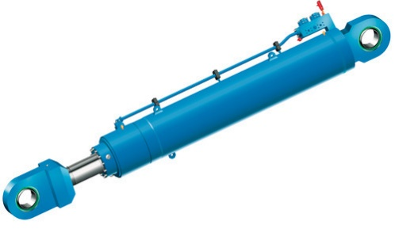
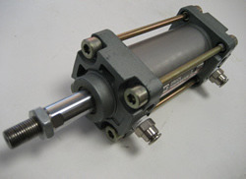
Actuators
These are basically devices that helps machines or robots to achieve movement in any direction. Actuators provides force/torque for motion.
5V DC Motor
5V Servo Motor
Linear Actuator
Stepper Motor
Hydraulic actuators
(fluid based)
Pneumatic actuators
(based on pressurized air)

Slide 4
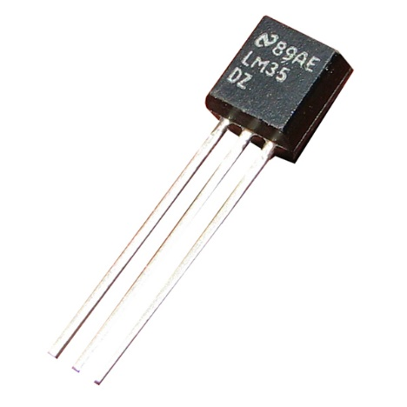
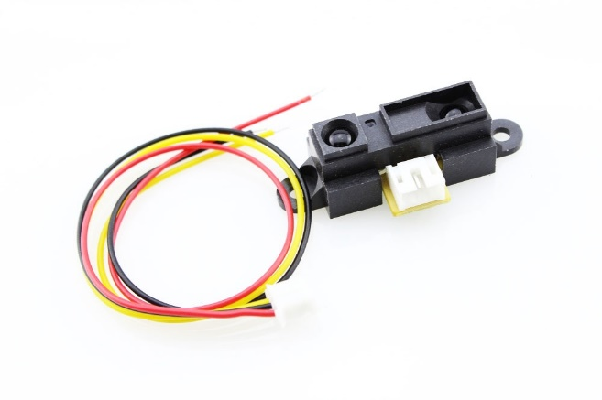
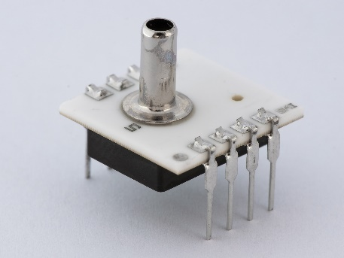
Sensors
A device that measures physical inputs from the environment and converts it into data that can be interpreted by either a human or machine.
Vision and imaging sensors
Temperature sensors
Radiation sensors
Proximity Sensors
Pressure sensors
LM35 Temperature Sensor
Infrared proximity sensor
Digital pressure sensor

Slide 5
Sensors vs Transducers
The term sensor is sometimes interchanged with transducer. This is not entirely wrong. The principal difference is that transducer will always convert its measurements to electrical signals. Some sensors, may not necessary convert measurements to electrical signals. For example, in a mercury thermometer, the mercury will simply expand to indicate variation in temperature.

Slide 6
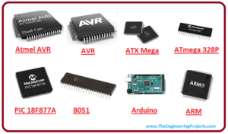
Controllers
A controller is digital device or system that controls the actions or operations of a robot.
The controller holds the computer program that implements the algorithm of the robotic system.

Slide 7
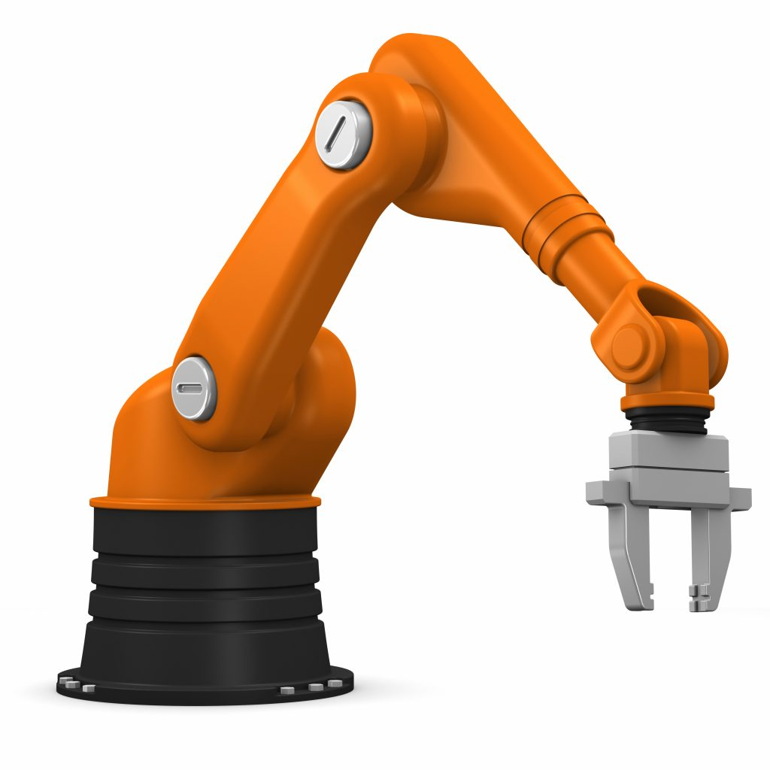
Manipulator Robot
A manipulator robot is an arm like equipment consisting of a set of mechanical, electrical, and electronic components that are programmed to perform repetitive tasks automatically.
The mechanism of a robot manipulator consists of two distinct subsystems, one (or more) end-effectors and an articulated mechanical structure:

Slide 8
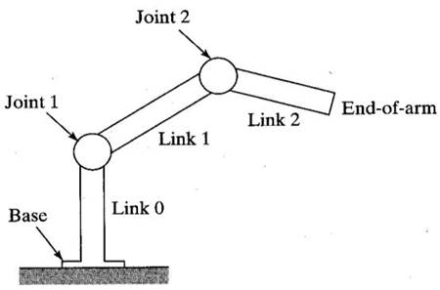
The role of the articulated mechanical structure is to place the end-effector at a given location (position and orientation) with a desired velocity and acceleration.
The mechanical structure is composed of a chain of articulated rigid links. One end of the chain is fixed and is called the base. The end-effector is fixed to the free extremity of the chain

Slide 9
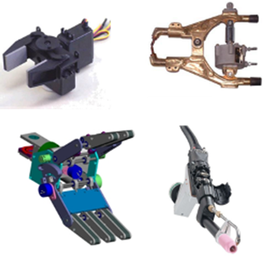
End-effectors
The End-Effector or End-of-Arm-Tooling (EOAT) is a tool or other device mounted at the end of a manipulator which it uses to accomplish useful task.
Typical end-effectors include magnetic, electric or pneumatic grippers, welding torches and paint guns. An end-effector may be multipurpose, i.e. equipped with several devices each having different functions.

Slide 10
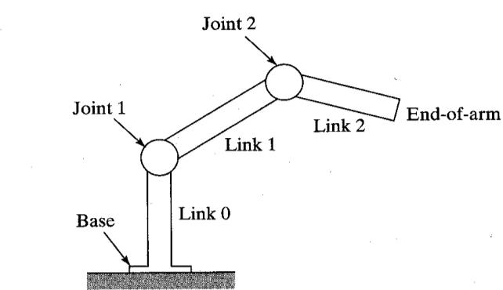
Joints and Links
Joint: The device which allows relative motion between two links in a robot.
Link: A rigid piece of material that connects joints in a robot.

Slide 11
Important terminologies in robotics
Kinematics is the study of motion without regard to forces/torques that are causing the motion.
Eg, for a particle accelerating along a straight line, we can study the velocity (initial and final) as well as the position of the particle without considering the force that initiated the motion.
Kinematics focuses only on the properties of motion such as displacement, velocity and acceleration.

Slide 12
Important terminologies in robotics cont’d…
Dynamics is the study of motion with regard to forces/torques. Calculation in dynamics will involve both masses and forces.
For the same example mentioned above, we will also be calculating the force that initiated the motion.
Dynamics is concerned with the properties of the forces, torques and moments of inertia.
Haptics means touch (in Greek)
DoF: Degrees-of-freedom refers to the number of independent motions a device can make.

Slide 13
Important terminologies in robotics cont’d…
Anthropomorphic means designed or appearing like human beings.
Workspace or work envelope is the volume in space that a robot’s end-effector can reach, both in position and orientation.
Position is the translational (straight-line) location of an object.
Orientation is the rotational (angular) location of an object.
Pose refers to position and orientation taken together.

Slide 14
Important terminologies in robotics cont’d…
Load Bearing Capacity is the maximum weight-carrying capacity of the robot.
Accuracy is the extent to which a robot can reach a target position without error. It is practically impossible to achieve absolute accuracy.
Repeatability is the ability of a robot to repeatedly execute a task with the same level of accuracy. A robot that possess high repeatability may possess low accuracy. Likewise, an accurate robot may not be repeatable.
Precision is the ‘fineness’ with which a sensor can report a value. For instance a sensor that reads 4.1167 is more precise than a sensor that reads 4.1 for the same physical variable. Precision is related to significant figures.

